Slide 1
PRESENTATION SKILLS
DEVELOPING PUBLIC SPEAKING - CLASSROOM

Slide 2

List the key principles for designing and delivering an effective presentation
Explain how to collect and structure relevant information for designing a presentation
Explain how to use body language effectively when presenting
Design and deliver a 5-minute presentation on a topic of your choice

Slide 3
Session introduction:
Presenting yourself
Deliver your presentation
Duration:
05:10 hours
1
3
2
From theory to practice: its your turn
Wrap up
4
5
Design your presenation

Slide 4




GROUNDRULES
?!

Slide 6
INTRODUCING YOURSELVES
PRESENT YOURSELVES

Slide 7
INTRODUCING YOURSELVES
Individual activity
Your name
Why are you here? What would you like to learn today?
Something about yourself
How confident would you rate yourself in terms of public speaking and what defines that rating?
2 minutes for reflection and note taking
1 minute to present yourself

Slide 8
A QUICK QUESTION ...
Have you ever presented in front of an audience?
If yes, how did it feel?
How do you think it went?

Slide 9
ANOTHER QUICK QUESTION ...
Have you ever seen someone presenting?
If yes, what made it so good ... or maybe ... not so good?

Slide 10
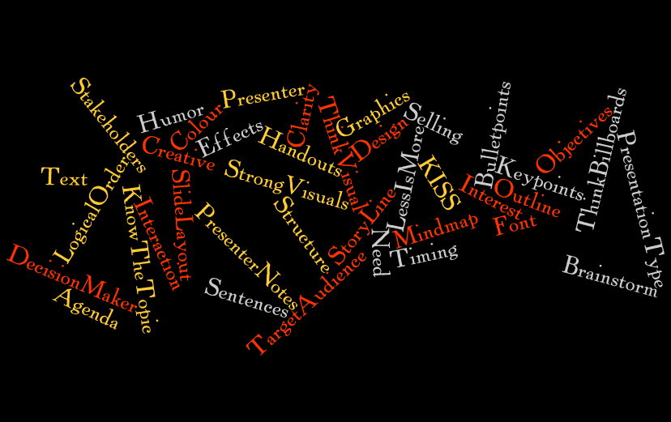
FOR A SUCCESSFUL PRESENTATION ...

Slide 11
USING PRESENTATION SKILLS
For example….
To present or make a speech at a conference or event
To deliver a speech at a wedding
To publicly thank someone
On behalf of a team, to say goodbye to a colleague who is leaving
To seek investment or a loan to help you set up a new business.

Slide 12
THE IMPORTANCE OF PRESENTATION SKILLS
By presenting well and communicating effectively, you can:
Develop a competitive advantage during a job/internship search
Gain the respect of your peers
Express your ideas, views and needs better
Build your morale
Increase your self-confidence
Help building your career

Slide 13
DESIGNING YOUR PRESENTATION

Slide 14
KEY PRINCIPLES OF GOOD PRESENTATIONS
A
B
A
B
KISS ... Keep It Short & Simple
LESS is MORE

Slide 15



ATTENTION: WINOUT
What
The topic of the presentation
Interest
Raise the audience’s interest
Need
The reason for the audience to join your presentation.
Why is it beneficial for them?
Objectives
What is the presentation aiming for?
Outline
How will the presentation run (agenda)
Timing
The duration of the presentation

Slide 16

A GOOD STRUCTURE ... SIMPLE AS ABC
Introduction to draw ‘ATTENTION’
and raise interest
BODY to deliver the
messages clearly, short
and to the point (KISS)
CONCLUSION to make a Professional and memorable ending

Slide 17



RAISING INTEREST
Ask a question
Use nice images
Tell a story or anecdote
Use statements or quotes
Statistics and graphs
Humor (!!!)

Slide 18

BODY: HOW TO GET THERE
Brainstorm
Mind map
Leave out the unimportant bits
Bite size chunks of information
Logical order

Slide 19


CONCLUSION: SOS
Summary
Make sure the audience remembers the
key points (memorable ending)
Offer positive expectation
Ensure they leave the meeting with a
positive feeling
Say thank you, stay available ... and stop
Leave contact details in case of
further questions and ... stop!

Slide 20
A QUICK QUESTION ...
What is brainstorming and mindmapping?

Slide 21

BRAINSTORM: A CAPITAL CITY
Chinese food
United Nations
DHL
Grand Place
Manneke Pis
Janneke Pis
Taxis
Airport
Weather
Royal Palace
Chocolate
Music museum
Public transportation
Atomium
Restaurants
Museums
European Union
DHL Express HUB
Languages
Politics
History
Medieval Center
Mini Europe
Public transportation
Mussels
Museum natural history
Auto world
Museum of comic books
Dining
Pubs and bars
Trains
Music concerts
Environment
Summertime
Winter
Concert venues
Etcetera …

Slide 22
MINDMAP YOUR BRAINSTORM
(MORE DETAIL)
Milky
(MORE DETAIL)
Milky
(MORE DETAIL)
Salted Caramel
(MORE DETAIL)
Salted Caramel
(KEYPOINT)
Clubs
(KEYPOINT)
Restaurants
(KEYPOINT)
Pubs and Bars
(DETAIL)
flavors
(DETAIL)
flavors
(MORE DETAIL)
Crispy Crunch
(MORE DETAIL)
Crispy Crunch
(CHAPTER)
Sightseeing
(CHAPTER)
Food and Drinks
(KEYPOINT)
Typical food
(EXPLANATION)
Chocolate
(DETAIL)
Brands
(TOPIC)
Brussels
(DETAIL)
Production process
(CHAPTER)
Getting around
(EXPLANATION)
Beverages
(EXPLANATION)
Waffles

Slide 23
YOUR STORY

Slide 24
ACTIVITY – YOUR STORY
In groups of 3
Define a topic that you know a lot of
Brainstorm and write down all your thoughts
Create a mindmap using a Flip Chart
Decide: what is least relevant (unimportant)
20 minutes (you will be informed when to move on to the next stage)

Slide 25

PREPARING FOR A PRESENTATION
IF YOU FAIL TO PREPARE, YOU PREPARE TO FAIL

Slide 26
A QUICK QUESTION ...
What preparation would be required to design the content of a presentation?

Slide 27
PREPARING FOR PRESENTATION DESIGN
Choice of topic
Gathering all the facts (brainstorm)
Structure the content (mind-map)
Adapt to your audience (relevance / unimportant bits)
Consider which materials and methods to use
Set aside time to prepare!

Slide 30

QUESTION 1
What would be good reasons for developing your presentation skills?
Express your ideas, views and needs better
Increase your self-confidence
Help building your career
You will be offered a good job or internship
It will result in earning a lot of money
Your peers will admire you for it

Slide 31
QUESTION 2
What are the two key principles for designing presentations?
Keep it short and simple (KISS)
Less = More
Make it smart and speedy (MISS)
More = Best

Slide 32
QUESTION 3
What does the abbreviation ABC stand for?
Awareness
Brief
Closure
Attention
Body
Conclusion

Slide 33
QUESTION 4
Why is it important to Brainstorm and Mindmap when desiging content for a presentation?
It is a good way to find content for a presentation and subsequently structure the content in a logical way.
It is a great way to deliver a presentation when you are not sure who is the target audience for your presentation.

Slide 34
COMFORT BREAK
Let’s take a short break for 15 minutes and then we will resume

Slide 35
DELIVERING YOUR PRESENTATION

Slide 36
PREPARING FOR A PRESENTATION
IF YOU FAIL TO PREPARE, YOU PREPARE TO FAIL

Slide 37
A QUICK QUESTION ...
What preparation would be required for delivering your face-to-face presentation?

Slide 38
PREPARING FOR PRESENTATION DELIVERY
Content development
Ensure a date, time and location are set and agreed
Know the audience
Review the content: still up to date
Practice, practice ... and did I say ... practice?
Get a good night's sleep
Check material and equipment: all there, does everything work?
Visualize the first minutes and then ... relax and enjoy.

Slide 39
ANOTHER QUICK QUESTION ...
When you are in the audience during a presentation …
What are the things that make you switch off?
When do you stop listening?

Slide 40
SWITCHING OFF
Boring
“Don’t want
to be here!”
Not interested
Too much
Wrong communication
Too fast
Not fluent speech
Too long
Wrong message
Too difficult (or too easy)

Slide 41
SO THE PRESENTER MUST ...
Ensure it is interesting
Interact when possible
Boring
“Don’t want
to be here!”
Engaging design
Less = More
Not interested
Too much
Mind your body language
Slow down
Wrong communication
Too fast
Practice, practice, Practice
KISS
Not fluent speech
Too long
Know the audience
Level with the audience
Wrong message
Too difficult (or too easy)

Slide 42






HOW WE COMMUNICATE
Verbal (words)
100%
90%
80 %
70%
60 %
50 %
40 %
30 %
20 %
10 %
Verbal (words)
93%
Non-verbal: music
and dance
7%
Vocal (tone)
Vocal / tone (music)
38%
38%
Body language
Body language (dance)
55%
55%

Slide 43
BODY LANGUAGE

Slide 44
ACTIVITY - BODYLANGUAGE
Two groups
Define do’s and don’ts for:
Group 1: Movement and face (eyes / mouth)
Group 2: Posture, hands and arms
10 minutes to discuss and make notes
3 minutes FOR each group to present: ONLY USING BODY LANGUAGE!!

Slide 45



POSTURE
Stand in front of projector / screen
Balance from one leg to the other
Stand too close to people
Stand up-right (relaxed)
Respect personal space
Face your audience

Slide 46
HANDS AND ARMS
Scratch, pull pants, tap fingers, play with pen, rub/touch your face
Point fingers
Motion to correlate to your words
Open hand gestures

Slide 47
MOVEMENT
Walk up and down nervously
Move back and forward on camera
Be ‘all over the place’
Move with a purpose
Calm and smooth movement only

Slide 48
FACE (EYES / MOUTH)
Chew, drink or eat
Look at the ceiling or the floor
Roll your eyes
Watch at the clock (or cell phone)
Stare at one person or one place only
Drink, when needed, during a natural break
Keep in contact with the entire audience
Use your eyes to invite the audience and show enthusiasm

Slide 49


DEALING WITH ANXIETY
Know your topic and practice (practice makes perfect)
Take your time
Stress is normal and can even be helpful
Control your breathing, control your voice
Envision the first few minutes of your presentation

Slide 52
QUESTION 1
When presenting, why is it important to know your audience?
If you know the audience, you can have good fun with them and maybe there are some friends of yours in the audience
Knowing the audience enables you to tailor your presentation towards their level and information needs

Slide 53
QUESTION 2
Why would you want to visualize the first minutes of your presentation before you start?
It helps to envision how the presentation would run and with that it helps to relax prior to presenting
It is always great to dream of a successful presentation and it keeps the harsh reality at a distance

Slide 54
QUESTION 3
For which percentage accounts non-verbal communication?
93%
55%

Slide 55
QUESTION 4
Why is it important not to fingerpoint but to use open hand gestures instead?
Finger-pointing shows that the presenter is nervous and with that the audience stops listening
Finger-pointing is, in most cultures, considered rude and it does not engage the audience

Slide 56

DELIVER YOUR PRESENTATION
SUMMARY
CLICK HERE TO START FILM

Slide 57
COMFORT BREAK
Let’s take a short break for 15 minutes and then we will resume

Slide 58
FROM THEORY TO PRACTICE

Slide 59
YOUR PRESENTATIONS

Slide 60
ACTIVITY – YOUR PRESENTATIONS
Individual activity
Choose your topic
Prepare a 5-minute presentation applying what you learned
Deliver your presentation
Round of feedback
Preparation: 30 minutes
Presentation delivery: 5 minutes per person

Slide 62
WRAP UP

Slide 63
List the key principles for designing and delivering an effective presentation
Explain how to collect and structure relevant information for designing a presentation
Explain how to use body language effectively when presenting
Design and deliver a 5-minute presentation on a topic of your choice

Slide 64

CREATE AN ARTWORK
YOUR KEY TAKEAWAYS

Slide 65
YOUR KEY TAKEAWAYS
Individual
Think about what you learned today and create a drawing
Your key takeaways
Your current confidence level: how do you feel?
If confidence level changed: what caused that change?
Then present your drawing and explain to the group
5 minutes to draw
1 minute presentations

Slide 66


SOMETHING SWEET ... SOMETHING SOUR ...
Imagine that now you have to replicate this workshop for your friends.
What would you change / keep?

