Slide 1
CV Writing
Workbook

Slide 2
Identify your competencies, skills, experiences and present them in a compelling way
Write a Curriculum Vitae (CV)
Prepare for a job interview

Slide 3
LET’S LEARN FROM EXAMPLES
Stay in your current group.
Out of 4 CVs choose the best CV.
Write down per CV the positive and negative elements.
Choose Who you would invite for an interview
20 minutes
Notes:
Briefing: 2 minutes
Activity: 20 minutes
Debrief: 13 minutes
Briefing: Each group works with the same pack of 4 CVs. They have 20 minutes to choose the best CV based on content. (5 min per CV) Some CV's show too informal language, have mistakes, information that is missing etc. The groups have to explain why they choose these CVs.
Debrief: Ask each time a different group, what they thought about a specific CV. Don’t ask them yet which CV they thought was best.
E.g. Ask group 1 about the pro’s and con’s of the CV from Samina, (ask the other groups if they have anything to add)
Then reveal the slide per CV with the pro’s and con’s.
Ask group 2 about the CV from Michael (again ask the other groups if things were missed) and proceed with the other 2 CVs like this.
At the end when all the CV’s pro’s and con’s have been discussed, ask per CV which group would have chosen for it and keep the score. Then reveal which would have been the choice of the facilitators.

Slide 4
FEEDBACK ON CV 1 - ANITA
……
…
….

Slide 5
FEEDBACK ON CV 2 - ZAK
……
…No
….

Slide 6
FEEDBACK ON CV 3 - MICHAEL
……
…
….

Slide 7
FEEDBACK ON CV 4 - SAMINA
…
….

Slide 8
LIST YOUR ACHIEVEMENTS
Individual activity
List your achievements so far
Identify the skills that belong to each achievement
Use your workbook
10 minutes
Notes:
This is an individual activity. Every attendee writes about their own achievements and skills, however they can exchange ideas with their “neighbors”
Briefing: 1 minute
Activity: 10 minutes
Debrief : 5 minutes
Debrief: Ask five volunteers if they would like to share an achievement and the respective skills with the group.

Slide 9
WHAT ARE MY ACHIEVEMENTS?
Skills
Sports, teams and clubs
Skills
Sports, teams and clubs
Teamwork
Resilience
Self motivation
Time management
Leadership
Played in the school football team
Skills
Achievements
Skills
Sports, teams and clubs
Notes:
Tell:
In the next activity we would like you to list your achievements so far, then identify the skills that belong to that.
E.g. coaching the football team -> enthusiast, motivating
Tell: Achievements can be work experience, hobbies, volunteering etc. Work experience is not a requirement to be able to do this activity.
Debrief: Students are voluntarily asked to share their achievements and skills they noted and get feedback from class trainer to get a “ best Practice” example.

Slide 10
WHAT ARE MY ACHIEVEMENTS?
Achievements
Skills
Skills
Achievements
Skills
Sports, teams and clubs
Notes:
Tell:
In the next activity we would like you to list your achievements so far, then identify the skills that belong to that.
E.g. coaching the football team -> enthusiast, motivating
Tell: Achievements can be work experience, hobbies, volunteering etc. Work experience is not a requirement to be able to do this activity.
Debrief: Students are voluntarily asked to share their achievements and skills they noted and get feedback from class trainer to get a “ best Practice” example.

Slide 11
WRITE YOUR CV
Individual activity
Use your workbook
Complete the elements of the CV
30 minutes
Notes:
This is an individual activity, however attendees can exchange ideas with their “neighbours”
Briefing: use your workbook and write down as much content as possible.
Try to apply the XYZ method to reformulate the achievements you noted earlier.
Briefing: 3 minutes
Activity: 30 minutes
Debrief : 5 minutes
Trainernote: in their workbook the attendees find a section for each element of the CV.
Debrief: 3 suggestions: (please let me know your preference)
Students exchange CV's in pairs and they give each other feedback, supported by the volunteers.
Students are voluntarily asked to share their achievements and skills they noted.
Students are advised to take part in a mentoring program to get personal feedback on their CV’s.
Ask: Is this the CV the only document you would send to a future employee?
Answer: Some companies require a cover letter.
A cover letter is a one-page document you send with your resume that provides additional information about skills and experiences related to the job you're pursuing. It typically includes three to four short paragraphs. A cover letter is important because it serves as the first chance for the recruiter to see the qualifications that make you a good fit for the position. Not every job application requires a cover letter, but it's a good idea to submit one. The extra effort not only shows the employer that you're serious about the job, but the letter differentiates you from other candidates.
Source: https://www.indeed.com/career-advice/resumes-cover-letters/what-is-a-cover-letter

Slide 12
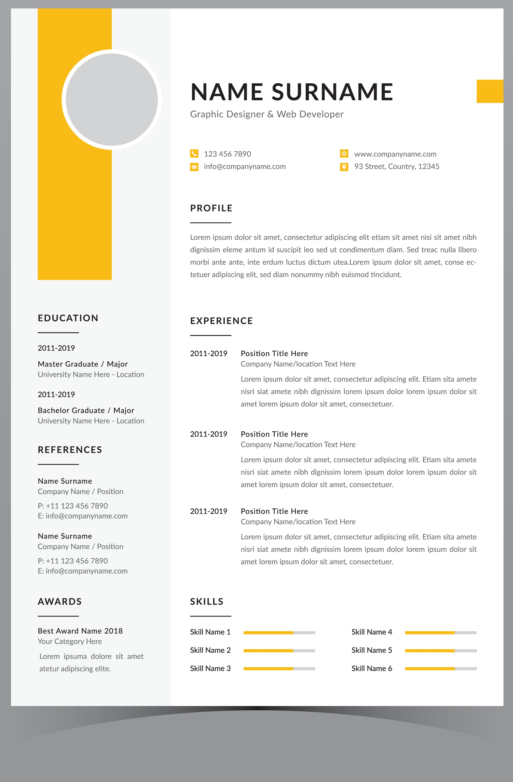
WHAT SHOULD BE INCLUDED IN A CV?
Interests
Hobbies
Contact details
Name*
Address
Phone number*
Email address*
Languages
Education*
Personal Statement*: 2/3 clear sentences about your overall experience and career aim (optional)
References
Work experience*
Additional activities
Courses
Certificates
Volunteering work
Skills and achievements*
*Must haves
Notes:
(Alison bending slide says not required is: Number, gender or age of any dependents (not sure what that means though)

Slide 13
WRITE YOUR CV
Contact Details/ Personal Statement
Contact details:
Personal statement:

Slide 14
WRITE YOUR CV
Education/Work Experience
Education:
Work Experience:

Slide 15
WRITE YOUR CV
Achievements and Skills
Achievements and Skills:

Slide 16
WRITE YOUR CV
Achievements and Skills
Interests/ hobbies:
Additional activities/ Courses/Certificates/Volunteering work

Slide 17
Disclaimer:
The material contains images from Shutterstock. These images cannot be used in any other materials by anyone without applicable Shutterstock licensing.
Some of the icons used in this material originate from Flaticon.

