Slide 1
GoTeach Reporting
Monthly TEAM Call, April, 2022

Slide 2
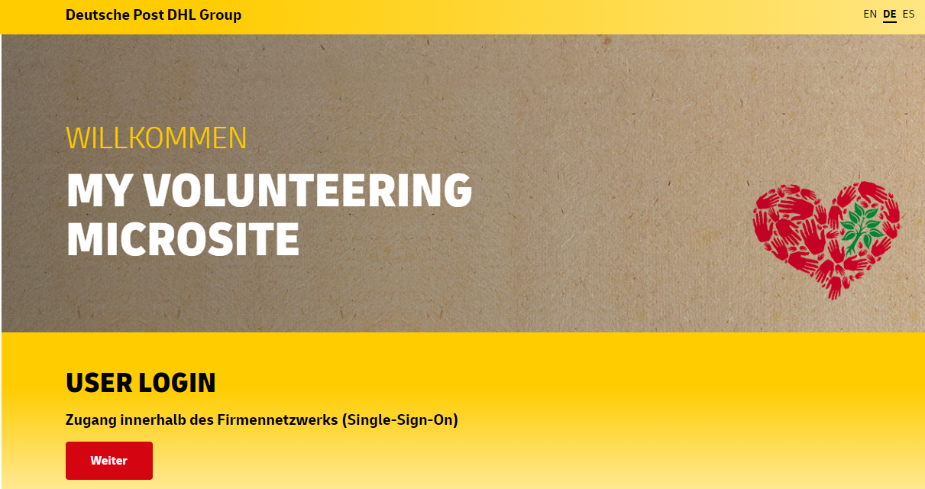
Reporting: Excel Template 2022
GoTeach reporting requirements to be collected by myVolunteering platform on activity level
We are expecting data to come in both VoMi and Excel in 2022 as this is a transitional year for us and then from 2023 we will move to ONLY VoMi for Activity KPIs, excel will be in place for strategic KPIs
Additional strategic GoTeach reporting requirements to be collected on country level
# of partnership activities that does not involve volunteering
# of young people from GoTeach partners who get a job at DPDHL in 2022
# of young people from GoTeach partners who get a job at DPDHL since launch of partnership
total # of young people participating in GoTeach
# of young people from GoTeach partners who participated in 3 or more interventions
# of young women participating in GoTeach
total # of volunteers in GoTeach
NEW!

Slide 3
Reporting 2022: Strategic KPIs
# of partnership activities that does not involve volunteering
# of young people from GoTeach partners who get a job at DPDHL in 2022
# of young people from GoTeach partners who get a job at DPDHL since launch of partnership
total # of young people participating in GoTeach
# of young people from GoTeach partners who participated in 3 or more interventions
# of young women participating in GoTeach
total # of volunteers in GoTeach
Explanation:
All young people who were offered an employment contract are considered, even if the employee has already left the company in the meantime

Slide 4
2022 Reporting Timeline
31 December
All activities are reported on myVolunteering microsite
All additional strategic KPIs are collected on country level and aligned between DHL and partners
Filled reporting template sent to Regional GoTeach Coordinators
Regional GoTeach Coordinators check plausibility and forward final results to Corporate GoTeach office
31 March
2022 Planning: activation plans finished
April/May
Info sessions for users: How to use the myVolunteering mircosite to report GoTeach activities?
“Lessons learnt” document from 2021 reporting shared by Amber
Q1
Q2
Q3
Q4
30 June
Regional GoTeach Coordinators generate first report on VoMi to check country entries
Collect feedback from countries/regions on issues they face in reporting GoTeach activities
30 September
Regional GoTeach Coordinators generate second report on VoMi to check country entries

Slide 5
Getting prepared for Reporting?- Next Steps
Does all country teams have access to My Volunteering Microsite?
Do all of you have Coordinator access on My Volunteering Microsite?
Have you received the Reporting Handbook and the new template?
Would you like to have info sessions on GoTeach reporting on VoMi?
Let us know !

